Slide 1


Your Guide to Performance Reviews

Slide 2
Contents
3
4
6
7
10
11
17
18
21
24
28
31
34
35
Dear colleagues……………………………………………………………………………………………….
Your Performance Review………………………………………………………………………………..
What to Expect………………………………………………………………………………………………..
Who does what……………………………………………………………………………………………….
Overview of the Process…………………………………………………………………………………..
Step by Step guide……………………………………………………………………………………………
Annual business and Team Priorities
Setting performance objectives
1-1s
Half year reviews
End or year performance reviews
What are the Performance Outcomes?…..………………………………………………………..
Measuring Performance…………………………………………………………………………………..
Measuring Performance - The What and the How……………………………………………
Values………………………………………………………………………………………………………………
Measuring Performance – Example………………………………………………………………….
Objectives……………………………………………………………….……………………………………….
Creating SMART objectives……………………………………………….………………………………
Glossary ……………………………………………………………….………………………………………….

Slide 3

Within O&CC we all have a role to play in shaping our businesses success, both in terms of today, and how we adapt to meet the needs of the future.
This booklet provides a framework for the behaviours we expect our people to demonstrate, and defines what we each need to do for us to be successful in our roles.
Please take the time to familiarise yourself with this booklet. We have an exciting business mission – To inspire people to get outdoors in a sustainable way – and we will only fulfil our potential if we are all engaged in the future of our business and pull in the same direction and support our ambitions.
Many thanks,
Claire Webber
People Department
Dear Colleagues

Slide 4
Performance Reviews are the process we all use to set expectations, review our personal objectives and development plans, and to make sure we are focused on delivering our priorities.
We all benefit from knowing what’s expected of us. Having clear, ambitious objectives and honest conversations about our performance is at the heart of the Performance Review process.
Performance reviews are made up of three areas that will be continually set, revised and reviewed:
Objectives
Development Goals
Performance rating
You will discuss these topic during the 1-1 meeting between yourself and your manager.
Your Performance Review

Slide 5
Why is the Performance Review Process Important?
For an individual
A clear understanding of what’s expected of you and how this supports wider business priorities.
Regular conversations with your manager – to ask for support and advice, and receive feedback.
Opportunities for you to outline your development and ambitions.
Recognition for the work you’ve delivered.
For a Line Manager
Clear objectives, with measurements, to deliver performance and continuous improvement.
Knowing what progress is being made and where there are any issues.
Keeping the team focused throughout the year and updated with changes.
Knowing the team – and supporting their development and ambitions.
Help manage poor performance.
For O&CC
Employees with clear objectives all add up to deliver effective company performance.
Engaged employees who know what’s expected
Employees have received the required development allowing them to deliver in their roles as well as to progress.
Ensures consistent and relevant way of rating employees’ performance.

Slide 6


What to expect
Annual launch of business and team priorities at the start of each year.
Clear objectives that make it really clear what’s expected of you.
Two formal reviews each year, which will combine for your full year ‘performance outcome’
Regular conversations about how you are progressing. (1-1s)
Helpful and regular feedback that celebrates success and encourages continual improvement.
Opportunities for you to discuss your development and ambitions.
To be treated fairly and respectfully.
To play your role in the process – by preparing for conversations with your manager and being honest about performance, issues, concerns and your development.

Slide 7

Who does what?
The Line Manager
Discusses the business and team’s priorities – helping individuals understand their own performance objectives and how they fit into the bigger picture.
Create clear SMART objectives that tie to the Business Objectives and Team Objectives
Provides individuals with job-specific objectives and their development goals
Prepares for 1-1s and reviews.
Regularly discusses an individuals progress with them.
Regularly reviews individuals performance objectives in line with priorities, and agrees any changes needed
Provides feedback to help keep individuals on track
Carries out reviews in a fair, consistent and respectful way – in line with our values.
Rates an individuals performance formally twice a year.

Slide 8

Who does what
The Individual
Draft objectives based on the team’s priorities for the year. Use ‘creating effective objectives’ on page 34 to help you. In some teams your manager will provide.
Make sure you clearly understand what is expected of you – in terms of both what you need to do and how you need to go about doing it.
Regularly discuss your progress with your manager – don’t leave it all to the formal reviews. You should reflect on your objectives and our values in assessing your own performance.
Prepare for reviews – gather evidence and feedback from others on how you’re doing.
Think about (and be honest in sharing) your development needs and ambitions with your manager.
Make sure your performance review information is up-to-date.

Slide 9

What About new Employees?
The Individual
All employees need to complete these reviews, regardless of whether they are in probation on not.
When rating a new employee’s performance – a manager should ask the question: ‘Are they on target?’ It may be that they are currently meeting your expectations, but in three months time, that same performance would be underperforming. A Manager should make sure that the employee is clear on your expectation and how this will change as their experience in role grows.

Slide 10
Overview
Jan - Feb
Hold end of year reviews
July -Aug
Mid year review
1-1’s will be conducted throughout the year that will:
Provide updates on Performance
Review and close objectives and Development goals
Create new objectives and Development goals
Feb
Annual launch of business and team Priorities
End of Feb
Individual Objectives for coming year &
continual development goals set

Slide 11
At the start of the year, the business will agree it’s priorities. These will then be communicated with everyone locally, trickling down team by team, with each team creating objectives that work to achieve the overall business goals.
It is a Managers role to translate the business goals to their own teams objectives.
The Manager will then need to outline what specific outputs in their area/ team will allow the business goals to be achieved, and how they will measure the degrees of success within their team. (What KPIs and what outcomes define what level of success).
Step 1

Slide 12
Managers will communicate the business and team goals with each individual in their team and will discuss how the individual’s objectives to the tie into the bigger picture.
The Manager may or may not ask for the individual to be involved in creating their own objectives based on achieving the team’s overall success goals.
Each objective will be SMART (see page 34 ) and have an agreed upon metric to measure the level of success of the objective. This will need to be agreed when the objective is being set, but may change throughout the objective lifetime, if circumstances change.
Both the Manager and the individual should come to this meeting considering any development gaps and development goals that they deem essential for their role (and the new objectives) and also for any aspiration roles for the future.
Finally, the manager will arrange times to regularly meet with the individual to conduct 1-1s to discuss progress, provide support and feedback.
Step 2

Slide 13
Throughout the year a Manager and the individuals in their team will meet together for short 1-1s.
During this time the individual will have the opportunity to update the manager on their progress against objectives and their development goals. This will also give the individual an opportunity to ask for advice or feedback, and the manager an opportunity to coach them, with any ongoing guidance.
This is also a great opportunity for the manager to find out how the individual is getting on personally and professionally, whether there is anything that the manager needs to be aware of, to change, or take into account to support the individual.
Step 3

Slide 14
The Mid Year Review takes place between July and August.
Before the meeting the individual should honestly assess their own performance and gather feedback, KPIs and evidence so that they are prepared. Remember, this is not just about what has been done, but also how it’s been done. (Has the individual demonstrated positive behaviours and acted within O&CCs company values? See pages 24 – 27)
The discussion will focus on:
What’s been completed – A formal review of the individuals progress against what’s expected of them in their role and their performance objectives.
How it’s been completed – How has the individual gone about delivering their objectives and in their role?
Progress with development goals- What further support is needed.
Following this meeting, the manager will confirm the half-year Performance Rating. The rating will be a combination of what has been done as well as how it’s been done.
Step 4

Slide 15
The End of Year Review takes place between Jan and Feb.
Before the meeting the individual should honestly assess their own performance and gather feedback, KPIs and evidence so that they are prepared. Remember, this is not just about what has been done, but also how it’s been done. (Has the individual demonstrated positive behaviours and acted within O&CCs company values? See pages 24 – 27)
The Manager will book time with the individual for the review. The discussion will focus on:
What’s been completed – A formal review of the individuals progress against what’s expected of them in their role and their performance objectives.
How it’s been completed – How has the individual gone about delivering their objectives and in their role?
Progress with development goals- What further support is needed.
Any aspirations that they have
Step 5

Slide 16
Calibration
The Manager will review their teams performance reviews against others in the business to ensure that they are calibrated correctly and in line with the company rating.
Following this, the manager will make any required amendments and combine the first and the second half-year Performance Ratings to create the end of year performance ratings for individuals in their team.
Following this meeting, the manager will confirm the full years Performance Rating. (A combination of what has been done as well as how it’s been done.)
Step 6

Slide 17
What are the possible Performance Outcomes?
There are five possible outcomes that you can be given in your performance review:
Under Performer The individual’s results of behaviour are some way off what is expected
Developing Performer The individual needs support and development to help them reach potential
Valued Performer The individual is a good solid and consistent performer
High Performer The individual consistently outperforms their peers in service and results
Exceptional Performer The individual is one of the top performers in the company
Under
Performer
Developing
Performer
Valued
Performer
High
Performer
Exceptional
Performer

Slide 18
Measuring Performance
It is important that managers rate the performance of their employees in a consistent manner, across the business.
The information on the following pages help a manager understand what defines a ‘high performer’ and what attributes makes them different from a valued performer.
To give further context, the graph to the right is a standard performance rating bell curve. It demonstrates what percentage of employees typically receive what performance outcome. For example; 68% of staff are expected to be rated as ‘valued performer’, 14% as a ‘high performer’ and 2% as ‘exceptional performer’.
The bell curve is never used to force people into a performance outcome, but does give managers context of what is the ‘norm’.
2%
14%
68%
14%
2%

Slide 19
Measuring Performance
For context, the table below lists the number of employees typically expected to receive each performance outcome (based on 1,500 employees within O&CC).
Performance Outcome | % of Employees | Number of employees
Under performer | 2% | 30
Developing Performer | 14% | 210
Valued Performer | 68% | 1,020
High Performer | 14% | 210
Exceptional Performer | 2% | 30
2%
14%
68%
14%
2%

Slide 20
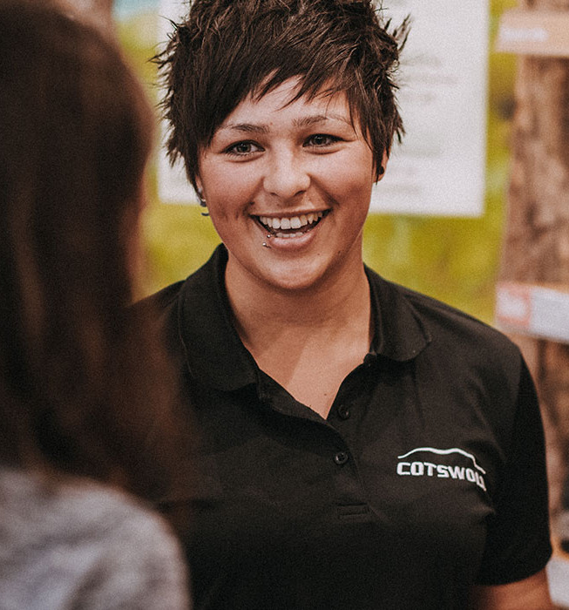
Measuring Performance
So, how does your manager get to an outcome to rate your performance?
Well, performance is based on your outcomes (performance of your day to day role and also your work on your objectives) and the way that an individual goes about it (their behaviours).
It would be wrong to rate performance on just their outcomes is they alienate their customers and their colleagues. Equally, it would be wrong to give someone a great review outcome if there are underperforming in their role, regardless of how positive their behaviours is.
As such you are rated on both ‘what’ you achieved and ‘how’ you achieved it.

Slide 21
Measuring Performance – The ‘what’
Does not meet expectations
Partially meets expectations
Fully meets expectations
Often Exceeds expectations
Always Exceeds expectations
A good, solid performer who fully meets expectations
Consistently achieves tasks and objectives and delivers against job profile requirements.
Meets expected quality standards for all work and output
Occasionally requires guidance and some direction
Trusted to ‘crack on’ and achieve good results once given direction
People Managers only - Consistently achieves against people objective
A high performer who always meets and often exceeds expectations.
Frequently goes the extra mile to deliver more than expected (results & service)
Proactive and when encounters challenges, comes to manager with solutions not problems
Drives opportunities and ideas that add value to the business
Little or no guidance or direction needed
The stand out performer
An outstanding performer who regularly, far exceeds expectations in all aspects of their role. (results & service
Plays a significant role in driving team/business success
Achieves exceptional, and sustained results
Their service, or results are held up as an example by managers from other teams
Frequently recognised by their customers and peers as delivering exceptional service
They stand out ‘head and shoulders’ above all others
Performance fails to meet expected standards
Consistently fails to complete tasks and objectives
Fails to deliver against job profile responsibilities
Demonstrates poor quality and/or productivity
Requires constant supervision and monitoring
Shows an unwillingness or inability to improve
People Managers only - Does not deliver against people objective (if a people manager)
An individual who meets some expectations but requires improvement
Shows some evidence of achievement against tasks and objectives
Shows some evidence of delivery against job profile responsibilities
Meets some of the expected quality standards
Requires frequent guidance and direction
People Managers only - Needs to focus more on achieving the people objective

Slide 22
Measuring Performance
For ‘what’ the ‘outcome’ that is being measured is very role dependent:
“Have you achieved Explore more sign up of 25%”
“Has your marketing reached x number of customer”
“Have you answered 95%+ pf all ICT tickets in 48 hours?”
A manager can easily see if the outcome has been met or not met and to what extent for each.
For ‘how’ an employee conducts themself (the behaviours) we turn to the values (see following page).

Slide 23
Measuring Performance – The ‘how’
Does not meet expectations
Partially meets expectations
Fully meets expectations
Often Exceeds expectations
Always Exceeds expectations
Rarely demonstrates expected behaviours
Behaviour may negatively impact on performance of self and others
Works to own agenda to the detriment of the team/business
Considers themselves an employee of a single fascia, not O&CC as a whole
Seen by others as not living the O&CC way
Takes little or no initiative, even when prompted
Demonstrates some but not all of the expected behaviours or demonstrates the expected behaviours inconsistently
Is receptive to feedback but may struggle to act on it in order to improve
Has potential to meet the required standards of behaviour.
May lack willingness or initiative to develop
Consistently demonstrates expected behaviours in line with the O&CC way
Willingly seeks and accepts feedback on behaviour in order to improve performance
Seen by others as a valued member of the team
Highly effective behaviours have a positive impact on results delivery and relationships with others
Is self aware and adapts behaviour to suit different people and situations
Is seen by others as exemplifying the O&CC way
Behaviours drive exceptional performance in role and relationships with others
Inspires others through leading by example and is viewed by others as a role model in support of the O&CC way.

Slide 24


Customers at the Heart of Everything
Delivering on Value
Not Delivering on Value
I care about understanding and meeting my customers’ needs
I treat my customers as an individual and adapt to them.
I recognise my role as a Subject Matter Expert and constructively challenge where appropriate
I consider more than just immediate customer needs by supplying additional resources support or other.
I treat every colleague /customer with respect & professionalism
I’m proactive in resolving customer issues and communicating delays or challenges
I play a part in maintaining the safety of our customer and colleagues at all times
I don’t actively listen, I do purely what I think is best regardless
I give the same treatment or outputs to all
I do purely what I am asked for with no consideration or actability if the requested solution is fit for purpose
I may get the job done but do not help to ensure the ongoing success
I am disrespectful, condescending, judgemental, discourteous, impatient or otherwise rude
I miss deadlines, agreed SLAs or need to be chased to respond or deliver work
I fails to notify or remedy (if appropriate) safety hazards once identified (regardless of who caused the hazard.)

Slide 25

Authentic
Delivering on Value
Not Delivering on Value
I’m honest with customers and colleagues
I’m willing to say “I don’t know” or “I don’t understand” and talk to others to find out.
I provides service in line with company ethos, sustainable, environmental etc.
I takes personal accountability and keeps my promises
I consider the impact of my actions on others and O&CC reputation
I make decisions about resources as if they are my own
I own the decisions I make and focus on finding solutions, not dwelling on problems
I understand how my work supports our customers and company performance.
I gossip / says one thing to management and another to colleagues. Or fail to acknowledge others’ contributions.
I see “asking for help” as a sign of weakness. Fail to seek advice and support, or to address development gaps.
I provide service that contradicts our ethos and values
I have ‘sloping shoulders’, ‘pass the buck’ or fail to deliver
I fail to consider the impact of my actions on others and O&CC reputation
I am blasé about how I use company resources
I behave as a victim when things do not go well and blame others for mistakes
I just get my head down and do the minimum needed in order to be left alone

Slide 26

Brave and Bold
Delivering on Value
Not Delivering on Value
I have the courage to challenge
I’m willing to adapt to new ways of working
I’m open minded (prepared to change my own opinion)
I suggests opportunities or highlights concerns but buy fully into a decision once it’s been made
I demonstrate a no-blame attitude
I encourages others to progress and develop beyond their zone of comfort
I take initiative, not needing others to get me started
I keep going, even in times of uncertainty
I take the initiate to try and if I fail, try once more.
Speaking up in an unconstructive manner, or choosing inappropriate forums, locations or times
Uses the “we have always done it this way” excuse to avoid or discredit change
Unwilling to give new ideas or concepts a fair opportunity
Repeatedly fights decisions that’ve already been made
Scared to put ‘head above the parapet’. Allows issues to go undiscussed rather than expressing an opinion
Calls out others for their failures or encourages apathy amongst colleagues
Maintains an ‘it’s some else problem’ or ‘not on my job description’ attitude. Always waits to be told what to do
I am afraid of failure so will not attempt a solution.

Slide 27

Passionate Experts
Delivering on Value
Not Delivering on Value
I strive for continual improvement
I take ownership of my own performance
I use feedback to improve my performance and act on it
I takes ownership of my own personal development
I share knowledge and skills with others
I go the extra mile on occasion
I proactively look for solutions to solve problems and issues as (or before) they appear
I approach my work with enthusiasm, energy and positivity, people can tell that I care about my work
I accept mediocre performance
I fail to buy in to targets set by my manager
I’m defensive or dismissive of constructive feedback
I fail to look for or address develop gaps
I hoards knowledge or only share information on a need-to-know basis
I work only to what is specified on contract, nothing else
I possesses the attitude, ‘they say, I do’ even when I believe there is a more productive approach
I can seem to bring others down with negativity, pessimism and apathy

Slide 28
Measuring Performance - Example
When a manager has reviewed the performance of an employees results (what) and behaviour (how), they will need to decide the overall outcome for that individual. As both are equally important, we ask our managers to use the following table to help them with this decision. (Example on following page)
Always exceeds expectations
Often exceeds expectations
Fully meets expectations
Partially meets expectations
Does not meet expectations
 | Does not meet expectations | Partially meets expectations | Fully meets expectations | Often exceeds expectations | Always exceeds expectations
Key
Exceptional Performer
Performance against Behaviours (How)
High Performer
Valued Performer
Developing Performer
Under Performer
Performance against Objectives (What)

Slide 29
Measuring Performance - Example
This individual ‘Partially Met Expectations’ on the behaviours half of the review and ‘Often Exceeded Expectations’ on the objectives half of the review.
The result is that the are a ‘Developing Performer’. (See Key)
Always exceeds expectations
Often exceeds expectations
Fully meets expectations
Partially meets expectations
Does not meet expectations
 | Does not meet expectations | Partially meets expectations | Fully meets expectations | Often exceeds expectations | Always exceeds expectations
Key
Exceptional Performer
Performance against Behaviours (How)
High Performer
End of year rating
Valued Performer
Developing Performer
Under Performer
Performance against Objectives (What)

Slide 30
Next steps – Action Plan
Exceptional performer | Essential to maintain motivation and unlock full potential. Identify challenging work and development opportunities that play to strengths. Consider readiness for next opportunity.
High performer | Highly likely to have appetite and potential for greater responsibility. A stretching development plan that builds on strengths to take them to next level.
Valued performer | Explore potential and appetite to do more at current or next level. Development plan with opportunities that provide further stretch and continued development.
Developing performer | Further development needed to reach all required standards. Development plan, with review dates to support individual in reaching full potential. A PIP may be a helpful tool here. Performance expected to move up to next level within 12 months.
Under performer | Performance concerns to be discussed immediately with individual and People team. Performance Improvement Plan (PIP) required, if not already in place. Development to support PIP to be agreed & documented.

Slide 31
Objectives
As part of the Performance Review Process, all manager are expected to create, feedback on and support their employees with objectives
What is and isn’t an Objective?
An objective is an task or activity in a specific area of focus. For example, doing your job as outlined by your job description is not an objective. However, taking part in a project to increase a specific KPI for your Department is.
Objectives
Managers will also set individuals in their team objectives based on specific needs. (see page 34 for information)
Team or Department Objectives
At the start of each year, the leadership team will outline the ‘Business Priorities’.
Managers will review these ‘Business Priorities’ and create ‘Team Objectives’ that will help achieve the ‘Business Priorities’.
In some teams, everyone in the team will be set the same objectives (as well as a few individual to them). As a Manager you can set ‘Group Objectives’ (See page 33)
‘People Manager’ Objective
People Managers will have a ‘pre-set’ objective regarding their management of the people in their team. (See page 32)
Personal Development Objective
All staff will be set a personal development objectives (in both halves of the year). The manager will set this based on what the staff member needs to develop in, for the benefit of the department. In addition, an employee may choose to complete an additional objective based on their own personal aspirations.

Slide 32

‘People Manager’ Objective
All Managers will be expected to be up to date on the following:
Performance Review process – All staff have received 1-1s, objectives, mid year reviews and end of year reviews
Health and Safety – All staff are up to date with their health and safety & the dept is ‘safe’ in terms of fire marshals and first aid. (and any other necessary)
‘People’ processes – Managers follow the correct processes for absence, resignations, requests for flexible working and all other ‘People’ discussions.
Feedback and Development – All staff are given feedback on their performance and conduct throughout the year and supported with their development.

Slide 33
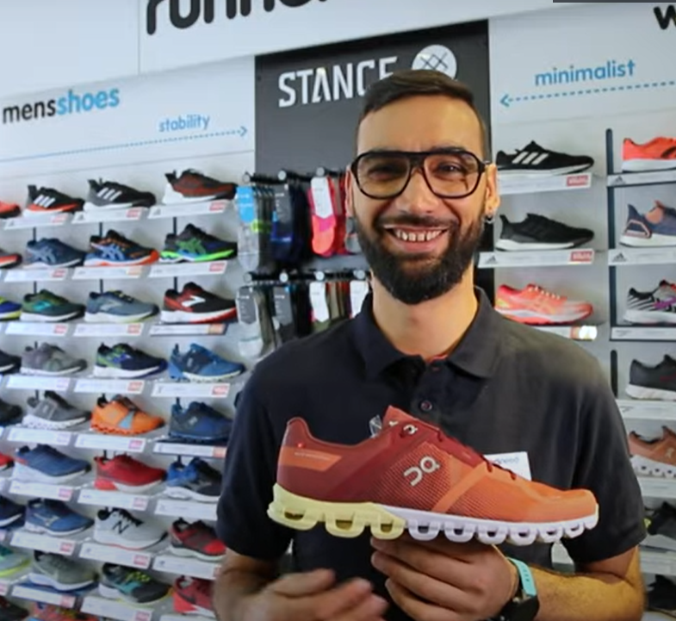
Setting Group Objectives
For Departmental Objectives, Managers will need to contact The People Team with the following:
What is the objective?
Who is this objective for?
When does this need to be completed by?
How will you know if they have been successful and how successful they are?
What support will they require?
Are they any recommended eLearnings that sit alongside this?
Any attachments?

Slide 34

Creating Effective Objectives
You’ve may well of heard of the S.M.A.R.T. approach to creating objectives. The
Be Specific. What is it you want to be achieved? ‘Action verbs’ are a great way to kick this off:
‘create’ ‘improve’ or ‘deliver’ etc. then specify a specific area the objective will impact Eg: ‘Improve customer satisfaction’.
Ensure the objective is Measurable. KPIs/ metrics are a great way to measure an outcome.
What support or development will you need to ensure that this objective is Achievable?
All objectives should be Realistic
What Timescales are involved? When is this due to be completed of reviewed?

Slide 35
Glossary
1-1: Regular meetings that an individual and their Manager hold to update on progress, concerns, queries etc.
Performance review: The review of an individuals performance over a set period of time.
Objectives: Tasks that a Manager sets that build into the dept or company strategy.
Development goals: Personal development goals – things the individual wants to learn more about, and also business development goals - what the business needs you to learn more about.
SMART: Specific, Measurable, Achievable, Realistic, Time-bound: this is a way to set tangible objectives
End of Year Review: The Review that combines your Q1&2 results with your Q3&4 results to get your yearly performance rating.

